Slide 2
Session 3: Decoding the Call
Proposal Writing Camp
How to understand and analyse a call
How to deconstruct a call text
Group work: Practical exercise on call decoding

Slide 3
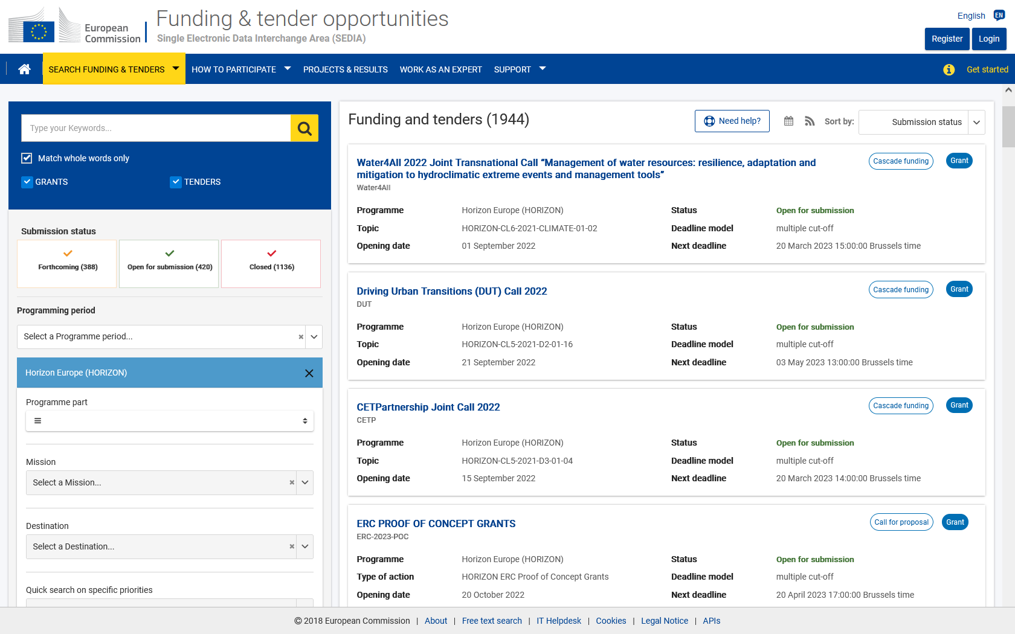
1. Finding, understanding and analysing a call https://ec.europa.eu/info/funding-tenders/opportunities/portal/screen/programmes/horizon https://ec.europa.eu/info/funding-tenders/opportunities/portal/screen/opportunities/topic-search

Slide 4
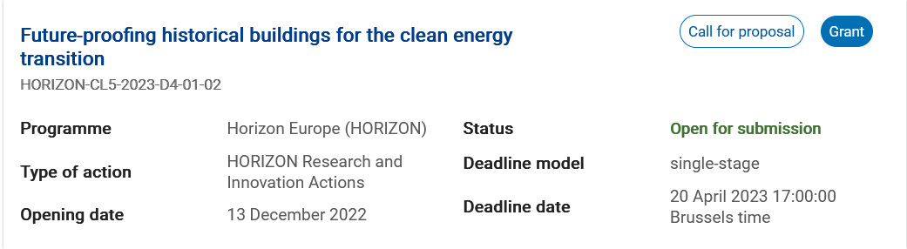
Call example

Slide 5
Glossary
CRITICAL RISK | A critical risk is a plausible event or issue that could have a high adverse impact on the ability of the project to achieve its objectives. Level of likelihood to occur (Low/medium/high): The likelihood is the estimated probability that the risk will materialise even after taking account of the mitigating measures put in place. Level of severity (Low/medium/high): The relative seriousness of the risk and the significance of its effect.
DELIVERABLE | A report that is sent to the Commission or Agency providing information to ensure effective monitoring of the project. There are different types of deliverables (e.g. a report on specific activities or results, data management plans, ethics or security requirements).
IMPACTS | Wider long term effects on society (including the environment), the economy and science, enabled by the outcomes of R&I investments (long term). It refers to the specific contribution of the project to the work programme expected impacts described in the destination. Impacts generally occur some time after the end of the project.

Slide 6
Glossary
MILESTONE | Control points in the project that help to chart progress. Milestones may correspond to the achievement of a key result, allowing the next phase of the work to begin. They may also be needed at intermediary points so that, if problems have arisen, corrective measures can be taken. A milestone may be a critical decision point in the project where, for example, the consortium must decide which of several technologies to adopt for further development. The achievement of a milestone should be verifiable.
OBJECTIVES | The goals of the work performed within the project, in terms of its research and innovation content. This will be translated into the project’s results. These may range from tackling specific research questions, demonstrating the feasibility of an innovation, sharing knowledge among stakeholders on specific issues. The nature of the objectives will depend on the type of action, and the scope of the topic.
OUTCOMES | The expected effects, over the medium term, of projects supported under a given topic. The results of a project should contribute to these outcomes, fostered in particular by the dissemination and exploitation measures. This may include the uptake, diffusion, deployment, and/or use of the project’s results by direct target groups. Outcomes generally occur during or shortly after the end of the project.

Slide 7
Glossary
PATHWAY TO IMPACT | Logical steps towards the achievement of the expected impacts of the project over time, in particular beyond the duration of a project. A pathway begins with the projects’ results, to their dissemination, exploitation and communication, contributing to the expected outcomes in the work programme topic, and ultimately to the wider scientific, economic and societal impacts of the work programme destination.
RESEARCH OUTPUT | Results generated by the action to which access can be given in the form of scientific publications, data or other engineered outcomes and processes such as software, algorithms,
RESULTS | What is generated during the project implementation. This may include, for example, know-how, innovative solutions, algorithms, proof of feasibility, new business models, policy recommendations, guidelines, prototypes, demonstrators, databases and datasets, trained researchers, new infrastructures, networks, etc. Most project results (inventions, scientific works, etc.) are ‘Intellectual Property’, which may, if appropriate, be protected by formal ‘Intellectual Property Rights’.
TRL | TECHNOLOGY READINESS LEVEL - See annex B

Slide 8
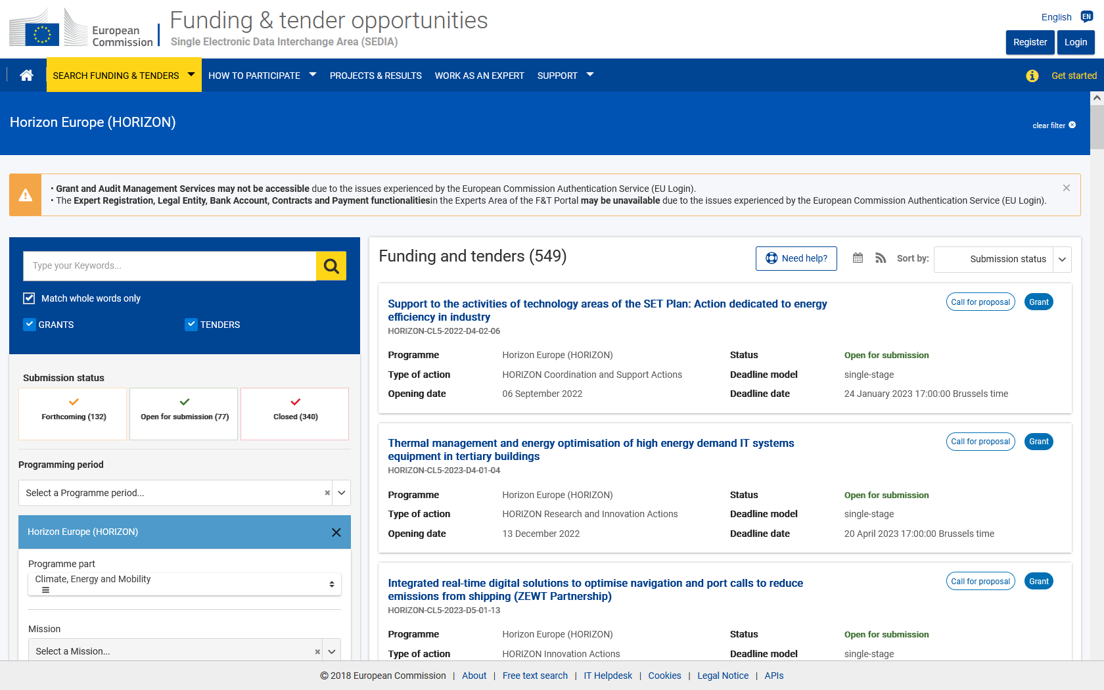
International cooperation in Horizon Europe Work Programme 2021-2022
Funding & Tenders Portal (FTP) – How to find a call? (I)
Left hand menu:
1) Select a programme – Horizon Europe
2) Programme part
https://ec.europa.eu/info/funding-tenders/opportunities/portal/screen/opportunities/topic-search

Slide 9
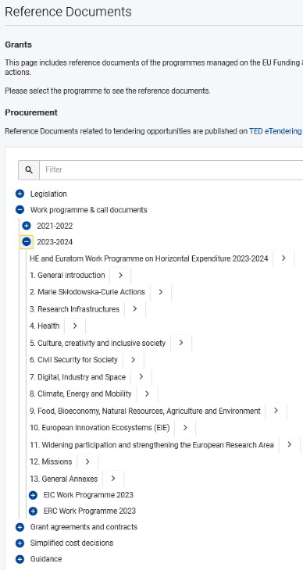

International cooperation in Horizon Europe Work Programme 2021-2022
2. How to find a call? (II)
What information do thematic
work programmes provide?
Introduction
Overview of the scheduled call(s)
  Description of the topics
  Call Key data:
    Opening date, deadline
    Type of Action (RIA, CSA, IA, etc)
    indicative budget per Topic/Call
    one-stage/two-stage procedure
    indicative date for evaluation outcome & grant signing
Budget
https://ec.europa.eu/info/funding-tenders/opportunities/portal/screen/how-to-participate/reference-documents;programCode=HORIZON

Slide 10
International cooperation in Horizon Europe Work Programme 2021-2022
Partner Search TOOLS
Use existing contacts with experience of EU funding programmes
Use Partner Search on the Funding and tenders portal: https://ec.europa.eu/info/funding-tenders/opportunities/portal/screen/how-to-participate/partner-search
Search the CORDIS database for participants in similar projects in FP7/H2020/HE: http://cordis.europa.eu/projects/home_en.html
Use social media (e.g. LinkedIn forums)
European NCP networks, National NCPs, COST actions…
https://ec.europa.eu/info/funding-tenders/opportunities/portal/screen/support/ncp
https://www.cost.eu/cost-actions-event/browse-actions/

Slide 11
2. How to decode a call text

Slide 12

Deconstructing a call text
Specific Conditions: main information about the call
Expected Outcomes: what is supposed to be achieved
Scope: presents what exactly is expected to be done

Slide 13
Example:
HORIZON-CL6-2021-BIODIV-01-11: What else is out there? Exploring the connection between biodiversity, ecosystems services, pandemics and epidemic risk
Topic ID
Expected EU contribution per project: between EUR 4 and 6 Million
Indicative budget: Total budget for the topic is EUR 12 Mililion
Type of Action: Research and Innovation Action
Eligibility conditions: see Annex B
Technology Readiness Level: Activities are expected to achieve TLR 3-5
Specific Conditions
Successful proposal will contribute to European Green Deal priorities and the EU biodiversity strategy for 2030, whilst supporting the EU’s response to the coronavirus and other zoonotic outbreaks, in the context of EU’s goal of leading just digital, economic and ecological transitions that will leave no one behind, One Health approaches, and the future European Health Union. Projects results are expected to contribute to […]
Expected Outcome
Wildlife microbiomes, whether symbiotic, commensal or pathogenic, and their potential to spread by crossing interspecies barriers, eventually reaching humans via transitional interfaces (e.g. peri-urban, farming areas), are still largely unknown. […] The impacts of land use and climate change on biodiversity, ecosystem services and pandemics should be also taken into account, as well as any recent IPBES reports on the links between biodiversity and pandemics […]
Scope
Notes:
Update this and the following slides with calls you plan to present and analyse with the participants in the Proposal writing camps.
Hide those slides that you don‘t need for a session.

Slide 14
Deconstructing a call text
Specific Conditions: main information about the call
Expected Outcomes: what is supposed to be achieved
Scope: presents what exactly is expected to be done
Outcomes …→ Impact
Research & Innovation Work to be done
Consortium
→ Check Destination as additional /background information
Notes:
Present how to proceed with call deconstruction with this and example at following slides. Then give participants call information you want to discuss at the PWC, and ask them to deconstruct it in group work. Discuss result.

Slide 15
3. How to deconstruct a call text
Group Work
Read carefully the Horizon Europe topic chosen as an example for the hands-on exercise;
Sort the information and highlight all words and sentences related to the colour code
Work Consortium Impact Budget

Slide 16
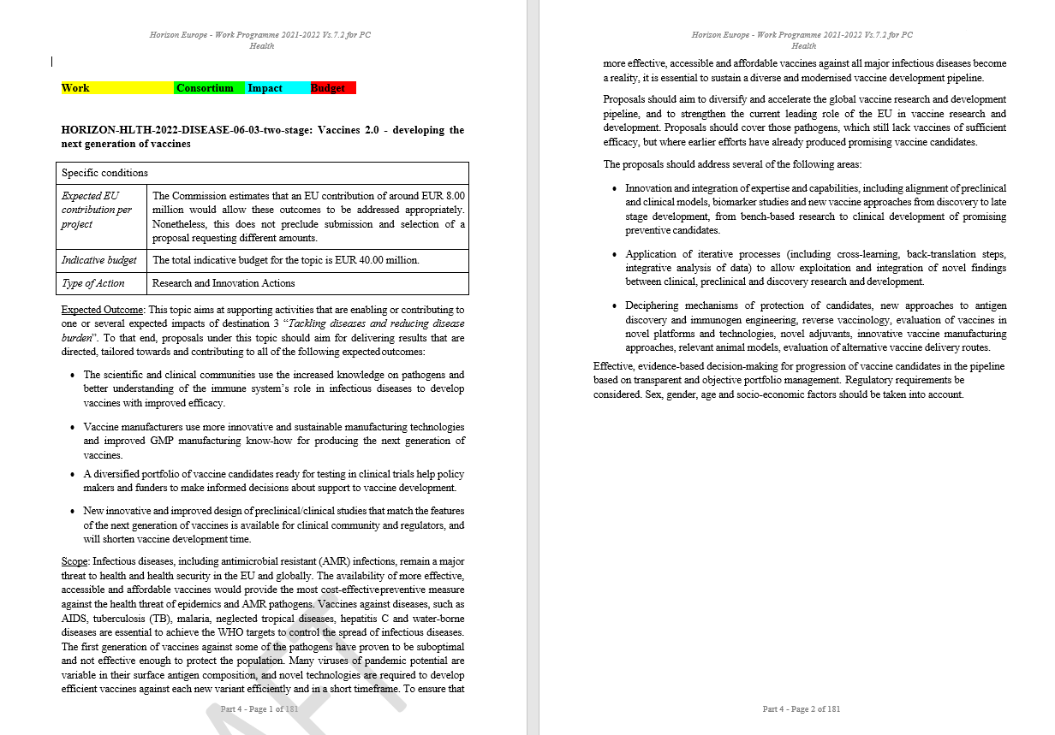

Slide 17
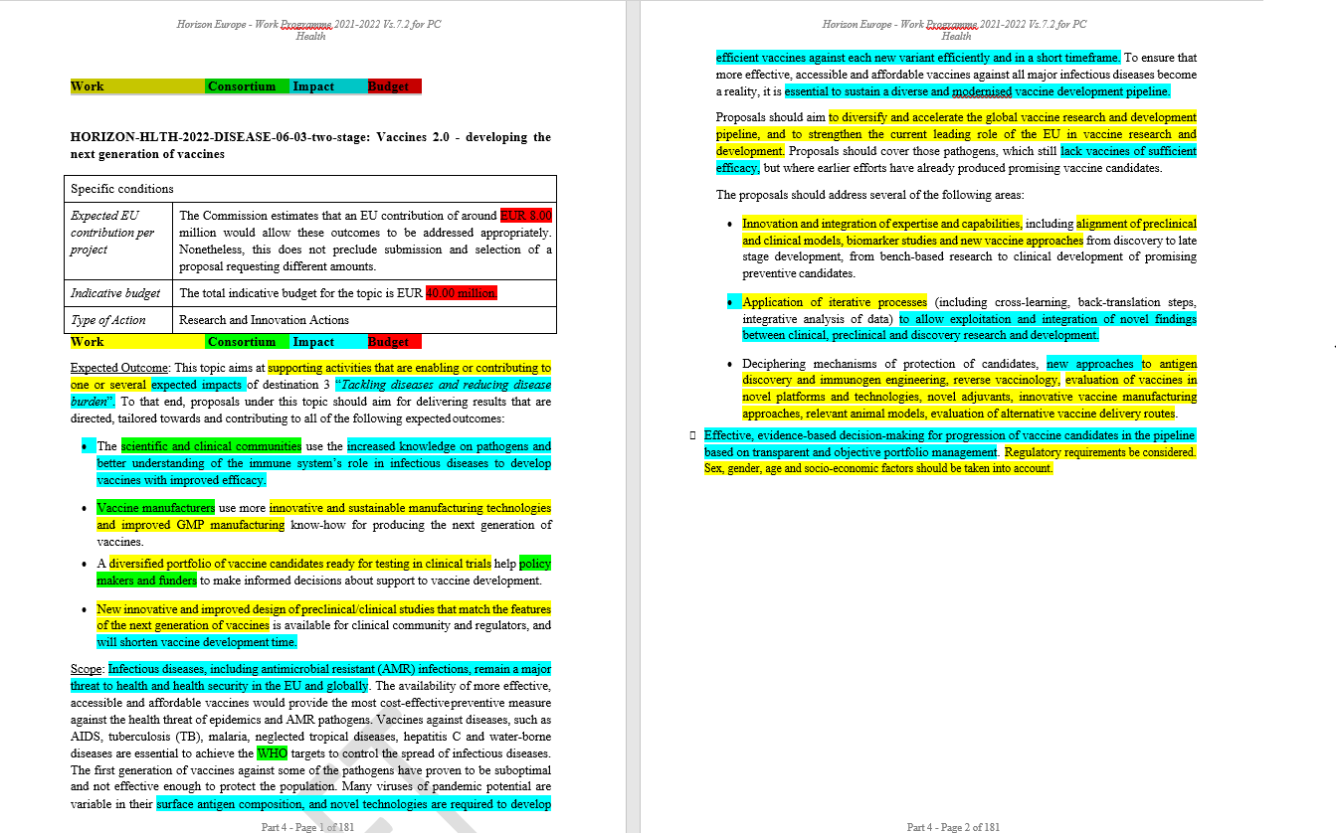

Slide 18
Call example
HORIZON-CL6-2021-CLIMATE-01-06 Resilient livestock farming systems under climate change Specific conditions
Expected EU contribution per project | The EU estimates that an EU contribution of around EUR 12.00 million would allow these outcomes to be addressed appropriately. Nonetheless, this does not preclude submission and selection of a proposal requesting different amounts.
Indicative budget | The total indicative budget for the topic is EUR 12.00 million.
Type of Action | Research and Innovation Actions (RIA)
Notes:
Additional call example.

Slide 19
Call example

Slide 20
Call example
Scope: Terrestrial livestock production is considered a large contributor to anthropogenic GHG emissions worldwide. Although emission intensity in Europe is lower in comparison to many other regions of the world, options to better assess and improve the emissions balance of terrestrial livestock production, weather intensive or extensive/low input, including organic, are necessary, including the evaluation of appropriate indicators of GHG emissions in different breeds, environments and production systems, in order not to rely solely on a reduction of the demand in food of animal origin to improve the emission balance of the sector. A variety of options have been identified, but are not yet common practice, and the potential of breeding to contribute to an improved GHG balance was not much investigated so far. In addition, the likelihood of further climate change occurring, and the increasing scale of potential climate impacts require addressing agricultural adaptation of the livestock sector as well.

Slide 21
Call example
The proposals should investigate at different levels (animal, herd, farm and sector, region) and with a coherent approach, practices and innovations that enable a reduction of the net GHG emissions by terrestrial livestock, while striving to ensure farm viability and resilience of productions systems, including adaption to climate change, and taking into account the impact on the environment and biodiversity. Trade-offs within and between the different levels should be addressed. At animal level, the research should use systems biology to study interactions between host and environment (e.g. feed and microbes) and how this interplay affects the efficiency of feed utilisation (energy and proteins) and GHG emissions, not least methane. Proposals will define and investigate traits/phenotypes, and the potential of breeding, to reduce GHG animal emissions or/and adapt to climate change. At farm level, different husbandry practices should be addressed. At sector/regional level, a system approach should investigate how different actors can cooperate to improve the GHG balance of livestock production, optimising the use of resources, including feed (e.g. production and origin), improving circularity. In addition to biophysical research, the proposals should address the potential socio-economic impact of the proposed practices and innovations, and look at options to facilitate their uptake. Proposals should develop or refine related tools for a proper assessment of practices and proposed innovations. Proposals should take into account novel farming systems and future scenarios, different breeds, particularly local breeds, various management approaches, climatic conditions and regional specificities. Proposals should address at least cattle and pigs and may address any other relevant species.
Proposals should fall under the concept of the 'multi-actor approach’ and ensure adequate involvement of the farming sector, terrestrial livestock breeders, advisers and other relevant actors.
The proposals should take into account other EU-funded projects, including those funded under the ERA-NETs SusAn and ERA-GAS .

Slide 22
3. How to decode a call text
Group Work

Slide 23
GROUP WORK:
Topic ID
Expected EU contribution per project:
Indicative budget:
Type of Action:
Eligibility conditions:
Technology Readiness Level:
Specific Conditions
Expected Outcome
Scope

Slide 24
Contact us!
George Bonas
Daniele Gizzi
eu-eap_sticooperation@servicefacility.eu
Notes:
Update contact details /e-mails.

Slide 25
Thank you!
#HorizonEU
http://ec.europa.eu/horizon-europe

